Slide 2
Boon Snapshot
The Boon Group® is a full-service employee benefits company specializing in the design, implementation and administration of cost-effective fringe benefit plans for federal, state and local government contractors. Since 1982, The Boon Group has developed a partnership philosophy that expands beyond the products and services we offer. We stand with the employers and employees who, just like all who work at The Boon Group, are faced with the daunting task of navigating the U.S. healthcare system.

Slide 3
The McNamara-O’Hara Service Contract Act (SCA)
Now Officially Called “Service Contract Labor Standards”
SERVICE CONTRACT ACT
1.
In General, service contractors have minimum hourly requirements for wages and benefits.
The hourly requirement for benefits is called a fringe rate. (However, sometimes these are called prevailing wages or H&W)
Because benefits are required to be tracked on an hourly basis, complications can arise from trying to fit a traditionally priced monthly benefit plan into an hourly requirement on a government contract.
enacted in
1965
2.
3.

Slide 4
Davis Bacon Act
DAVIS BACON ACT
enacted in
1931
1.
Protects communities and workers from competition caused by non-local contractors
Requires payment of:
a) Locally Prevailing Wages
b) Fringe Benefits
Requires weekly pay and certified payrolls
2.
3.

Slide 5
DAVIS BACON ACT
29 CFR 5.31
(a) A contractor or subcontractor performing work subject to a Davis Bacon wage determination may discharge his minimum wage obligations for payment
of both straight time wages and fringe benefits by paying in cash, making payments or incurring costs for “bona fide” fringe benefits of the types listed in the applicable wage determination or otherwise found prevailing by the Secretary of Labor, or by any combination thereof.

Slide 6
Important Considerations for Government Contractors:
SERVICE CONTRACT ACT
1.
Cost Savings. If a contractor can lower labor costs on an existing contract. This typically results in an immediate impact to their financials. Compounded over the life of a multi-year contract, the savings can really add up!
Competitiveness. Government Contracts are awarded for the most part via a very competitive bid process. In the Low Price Technically Acceptable (LPTA) arena, even a small savings in payroll can mean the difference between winning and losing contracts.
Compliance. The DOL.
The 3C’s
2.
3.

Slide 7
You Face Heavy Competition for Contracts
HOW TO BE MORE COMPETITIVE
Less than
5%
­­­­Many Contractors are bidding projects with a profit margin of less than 5%.
It will vary based on the work that you do and the fringes that are being paid.
It might be possible to lower the overall bid by 3% – 7%.-
If the job requires the same man hours and the same materials – how can you lower your bid?
BENEFITS can be part of the answer

Slide 8
HOW TO BE MORE COMPETITIVE
Problem:
Paying the fringe portion in cash is the most expensive way.

Slide 9
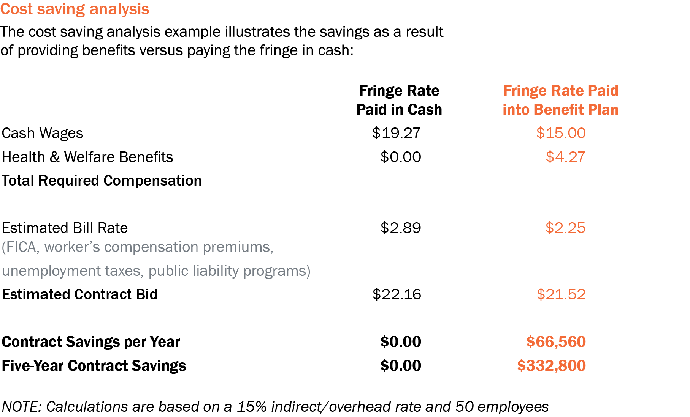
Competitiveness
The best way to quickly become more competitive within the government contracting industry is to contribute the designated fringe rate to a bona fide benefit plan rather than pay cash to the employees.

Slide 10
Benefits Can Make All the Difference
Example:
Construction Company A:
Prevailing Work Force of 100 employees
Fringe Rate: $8.00
Average hours worked 2,000
Total Fringe: $1,600,000
Typical Payroll Taxes:
FICA 7.65%
WC 15.00%
FUTA 1.60%
SUTA 1.40%
25.65%
Annual Savings by
Paying in benefits: $410,400
Payroll Tax Savings:
taxes don’t apply to benefits
“Products and marketing support are provided by The Boon Insurance Agency, Inc. and administrative services are provided by Boon Administrative Services, Inc., wholly owned subsidiaries of The Boon Group, Inc.”

Slide 11
Compliance and Audits
HOW TO BE MORE COMPETITIVE
The Contracting Officer or DOL can audit you to verify that employees were paid what they were owed:
Keep track of hours worked on each job – Maintain accurate records to whom the fringe was paid and the benefits that were received
When using Fringe money to pay for benefits – it must be made payable to a third party and it must be irrevocable
Hours Worked
Fringe Money

Slide 12
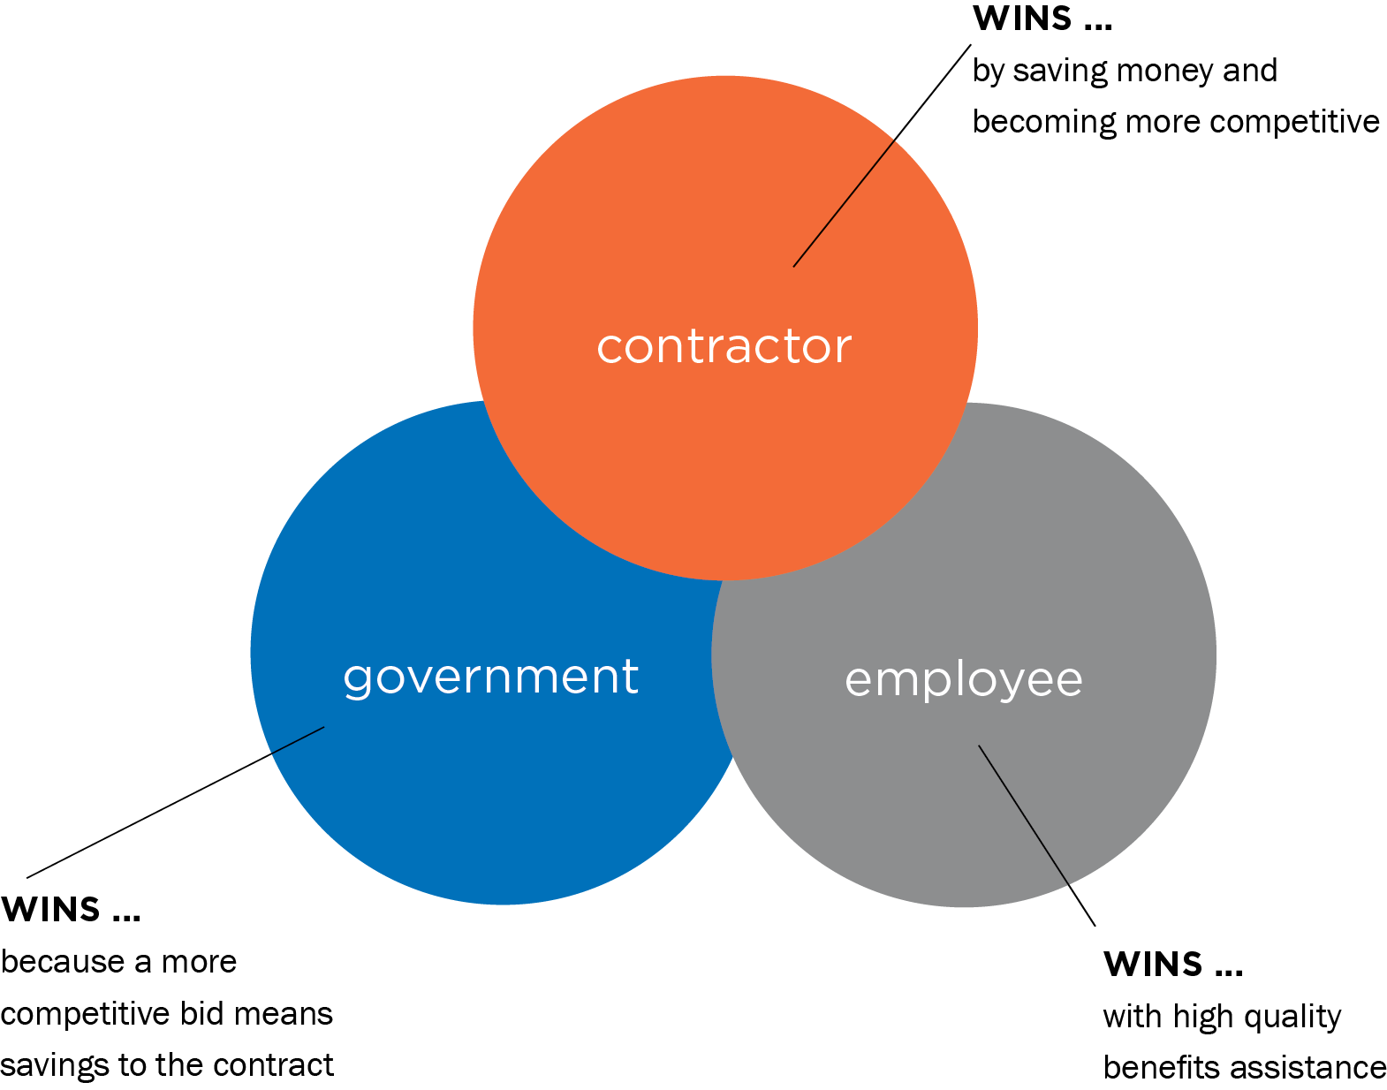
Compliance
The Winning Solution–
Under contracts where the fringe amount must be allocated individually, compliance is achieved when the employer spends the exact amount of the fringe obligation (fringe rate times hours paid) to provide bona fide fringe benefits.

Slide 13
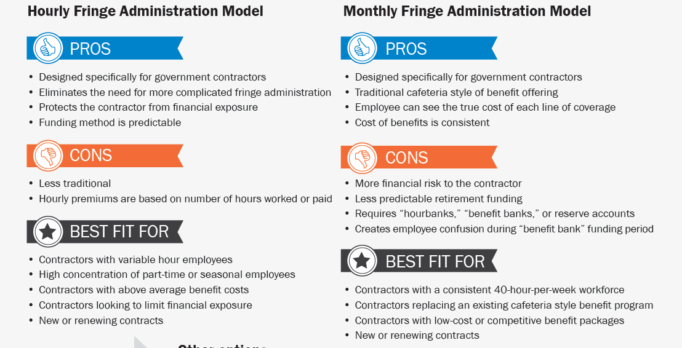
Flexibility
Is an hourly priced plan better than a traditional medical plan?
Understand the Difference
Recommend the Best

Slide 14





Contact Info:
Brent Adams
Regional Sales Manager
Mountain / West Region
512-680-9380 direct / cell
badams@boongroup.com
Connect with us on:

