Slide 1
A DAY WITH DCAA AND DCMA
Understanding Government
Contract Compliance
March 28
2019

Slide 2
AGENDA
7:30 | Registration/Breakfast
8:00 | Welcome and Introductory Remarks
8:20 | Keynote Speaker - Rich Burchfield, Executive Director, Catalyst Campus for Technology and Innovation
8:40 | Overview of DCMA/DCAA Roles and Responsibilities
9:40 | Break
10:00 | Accounting Systems for Small Business from a DCAA Perspective
11:00 | Pricing Proposals - What is and is not Certified Cost and Pricing Date
12:00 | Lunch and Networking Time
1:30 | The Supply Chain - The Role of DCMA in Monitoring the Subcontract Process
2:30 | Panel and Open Question Forum
3:30 | Happy Hour and Networking

Slide 3
Rich Burchfield
Executive Director, Catalyst Campus for Technology and Innovation
Rich leads a dynamic team that creates a collaborative ecosystem where industry, small business, workforce training, entrepreneurs, startups and venture capital intersect with Colorado’s aerospace and defense industry to create community, spark innovation and stimulate business growth. Catalyst Campus provides an infrastructure platform for small business to support the rapid innovation of technology to solve operational needs for the warfighter.
Previously, Rich served as Chief Defense Development Officer for the Colorado Springs Chamber & EDC where he led community engagement with military and aerospace and defense industry. Rich also served nearly 30 years in the U.S. Air Force (Colonel, Retired), splitting that time in half between active duty and the Air Force Reserves (space and missiles). In parallel to his Reserve assignments, Rich worked full-time in the defense industry sector for over 16 years supporting USSTRATCOM, Army Space and Missile Defense Command, HQ AFSPC, Missile Defense Agency and HQ NORAD & USNORTHCOM.

Slide 4
ABOUT THE DCAA
The Defense Contract Audit Agency (DCAA) provides audit and financial advisory services to Department of Defense (DoD) and other federal entities responsible for acquisition and contract administration.
DCAA operates under the authority, direction, and control of the Under Secretary of Defense (Comptroller)/Chief Financial Officer.
Prior to 1965, each U.S. military branch had separate contract audit functions and regulations. Contractors and government personnel recognized the need for consistency, and Secretary of Defense Robert S. McNamara instituted "Project 60" in May, 1962, to examine whether it was feasible to centrally manage contract administration and audit activities. An outcome of this study was the decision to establish a single contract audit capability - the "Defense Contract Audit Agency." DCAA began providing audit and financial advisory services to Government contracting officials on July 1, 1965.

Slide 5
Joseph Greger
SMALL BUSINESS PROGRAM MANAGER
DEFENSE CONTRACT AUDIT AGENCY
Mr. Greger is the Small Business Program Manager and is located at DCAA Headquarters in Fort Belvoir, Virginia. In this capacity, he serves as the program manager and audit expert for the small business program with responsibility to provide assistance, consultation and internal control with regard to audit requirements and their application to small business.
Mr. Greger graduated from California University of Pennsylvania with a Master of Science in Business Administration and a Bachelors in Accounting. He began his DCAA career as an Auditor at the Herndon Branch Office in Northern Virginia. He was promoted to Supervisory Auditor then Branch Manager at the Springfield Branch Office. Mr. Greger has also served in Headquarters as an OWD Program Manager in the Operations Directorate.

Slide 6
Charity Cramer
Supervisory Auditor
Ms. Cramer is one of two Supervisory Auditors in the Colorado Springs Branch Office that supervise audits of the small business contractors in the Colorado Springs area. There are a total of nine Auditors working at the Branch Office performing these audits.
Ms. Cramer graduated from the University of Wisconsin – Whitewater with a Master of Professional Accountancy and a Bachelor of Business Administration. She obtained her Certified Public Accountant license in Wisconsin. She began her DCAA career as an Auditor at the Wauwatosa Suboffice in WI. She served as an Auditor in the Germany DCAA office for three years, was promoted to Supervisory Auditor in Colorado Springs over a large contractor, and transferred to small business contractors in 2018. She recently returned from an 18-month deployment in Afghanistan with the Civilian Expeditionary Workforce.

Slide 7
Andrea Denning
Senior Auditor
Ms. Denning is a Senior Auditor located at the DCAA Denver Branch Office in Lone Tree, Colorado. In her 11 years with the Agency, she has conducted a variety of audit assignments at various major and non-major contractor locations.
Ms. Denning graduated from the University of Houston-Clear Lake with a Master of Science in Accounting and is a Certified Public Accountant (CPA) in the State of Colorado.

Slide 8
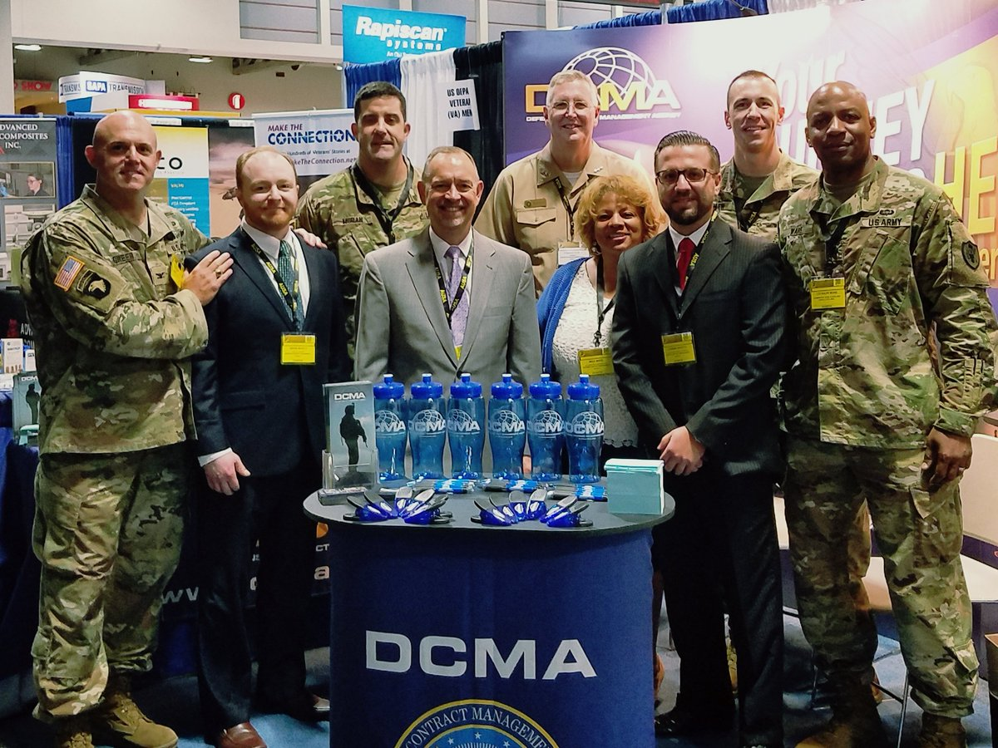
ABOUT THE DCMA
The Defense Contract Management Agency (DCMA) provides contract administration services for the Department of Defense, other federal organizations and international partners, and is an essential part of the acquisition process from pre-award to sustainment.
Around 12,000 employees, mostly civilians, work at offices and contractor facilities around the world, divided among three continental U.S. commands, one international command and other specialized offices.
Together, the Agency manages 350,000 contracts, valued at more than $5 trillion, at 19,000 contractor locations worldwide. DCMA makes sure DoD, other federal agencies, and partner nation customers get the equipment they need, delivered on time, at projected cost, and meeting all performance requirements.
Every business day, DCMA receives nearly 1,000 new contracts and authorizes more than $650 million in payments to contractors. Most importantly, every day our team delivers more than a million and a half items – from fighter jets to fasteners – to our warfighters.

Slide 9
Colonel Kenneth Warcholik
Commander, DCMA – LM Denver Contract Management Office
Col Warcholik manages more than 190 military and civilian professionals and provides contract administration services, quality assurance and engineering support for over $36B worth of acquisitions, including space launch vehicles, satellites, missile defense, and intelligence programs. Major customers include the U.S. Air Force, National Aeronautics and Space Administration, and Missile Defense Agency. Col Warcholik assumed his current position in July 2013.
Col Warcholik entered the Air Force in 1991 and has served in various test, engineering and acquisition management assignments including instrumentation engineer for the Titan IV launch system, spacecraft integration manager on Pegasus and Taurus launch vehicles, chief of microwave sensors for the DMSP, program manager for advance imaging sensors for Predator, Global Hawk and U-2 aircraft, chief of concept development for SMC, and program manager for a classified intelligence satellite system.
His certifications include
Program Management- Level III
Systems Planning, Research, Development and Engineering - Level II
Test and Evaluation - Level I

Slide 10
Joseph Cullen
Integrated Cost Analysis Team Director
Mr. Cullen joined DCMA in July 1995 and is currently responsible for leading and managing a multifunctional team of 20 Engineers and Contract Price/Cost Analysts who are the leading experts in complete proposal analysis and negotiations support, evaluating over $3B proposed annually for space launch vehicles, satellites, missile defense and intelligence programs. Major customers include the USAF, Navy, NASA and MDA.
Mr. Cullen has held various positions including Chief Engineer, Engineering SME, Lead Engineer (Atlas Launch Vehicle),and Computer Engineer. He has also managed teams of engineering, software and manufacturing personnel, performing acquisition life cycle contract management/administration services on major programs, ensuring on-time, within cost, delivery of quality products and services to the warfighter.
Mr. Cullen is a member of the Defense Acquisition Corps and is DAWIA Level III Certified in Systems Engineering, Acquisition Program Management and Production, Quality & Manufacturing.

Slide 11
Raymond Carter
SUPERVISORY CONTRACT SPECIALIST
Mr. Carter is currently a Supervisory Contract Specialist at the sub-office in Colorado Springs Colorado.
Mr. Carter holds a DAWIA Level III Professional Certification in Contracting and a Master’s Degree in Procurement and Acquisition’s Management with a Certificate of Government Contracting.
Mr. Carter has 35 years of contracting and acquisition experience. Prior to his appointment as Supervisory Contract Specialist, he served as a DCMA Price Cost Analyst, U.S. Air Force and Army Contracting Specialist. Mr. Carter also served 20 years in the Air Force where he performed duties as an Engineering Technician and Contract Manager on base level service and construction contracts. He also performed surveillance on U.S. Army Corps of Engineers projects at CONUS and OCONUS locations.

Slide 12
J. Michael Whelan
Director, DCMA CIG West Technical Team
Mike Whelan is the DCMA Commercial Item Group (CIG) West Technical Team Director located in Denver, Colorado. Mr. Whelan has been working for DCMA for 10 years in multiple different positions to include systems engineering, technical pricing support, and commercial item support. Mike led the development of the DCMA Commercial Item Support training and has been actively partnering with Defense Acquisition University (DAU) to develop a commercial item workshop and computer based training for all DoD acquisition personnel. Additionally, he holds a Level III Professional Certification in Engineering, is a member of the Defense Acquisition Corp, and holds a Masters of Business Administration.

Slide 13
ABOUT AFSPC Small Business Programs
The Small Business Program office maximizes small business opportunities within Air Force Space Command’s acquisitions, thereby (a) promoting efficiencies and innovation, (b) fostering competition, and (c) expanding the defense industrial base.
The AFSPC Small Business Program is dedicated to increasing small business participation in the acquisition process. Our outreach to the small business community increases the number of innovative suppliers in the industrial base, which increases the government's access to new solutions and technologies that would not be available without your participation.

Slide 14
Reggie Selby
Director, Small Business Programs – 21st SW
Acting Director, Small Business Programs - AFSPC
Mr Selby holds a Level III Professional Certification in Contracting and a Level I in Program Management under the Acquisition Professional Development Program
Mr Selby has 27 years of contracting and acquisition experience. Prior to his appointment as the 21st Space Wing Small Business Director, he served as Deputy Director of Subcontracts for a major defense contractor. Mr Selby also served 21 years in the Air Force where he performed duties as a missile officer, airborne launch control officer, and as an acquisition officer.

Slide 15
Gary Monson
COST/PRICE ANALYST
Mr. Monson is currently the Cost/Price Analyst for the 21st Contracting Squadron, Peterson AFB, Colorado.
Mr. Monson holds a Level III Professional Certification in Contracting and holds an Unlimited Contracting Officer Warrant.
Mr. Monson has 11 years of contracting and acquisition experience. Prior to his appointment as the Cost/Price Analyst, he served as a Contracting Officer for Specialized Programs within 21st Space Wing. Mr. Monson also worked 2 years as a Planner/Buyer for a major defense contractor.

Slide 16
THANK YOU TO OUR SPONSORS!

Slide 17
THANK YOU!

