Slide 1
DCMA Familiarization
Colonel Ken Warcholik
Commander, DCMA Lockheed Martin Denver
28 March 2019
Unclassified//For Official Use Only

Slide 2
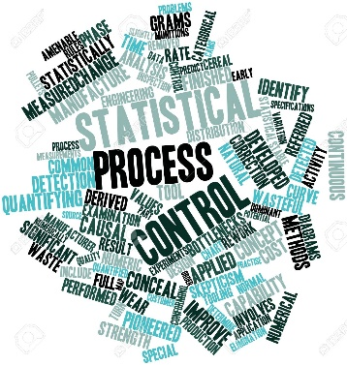
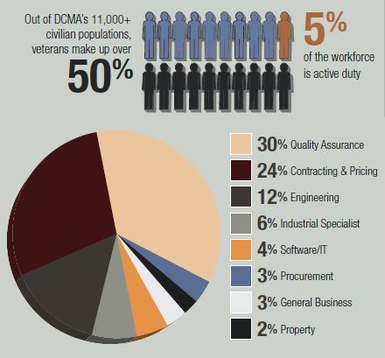
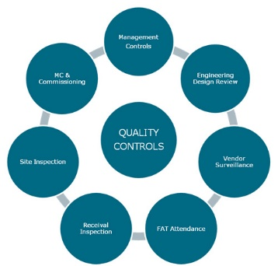
What is Contract Administration Services (CAS)?
Contract Administration Services (CAS)
DAU – Glossary of Defense Acquisition Acronyms & Terms:
All actions accomplished in or near a contractor’s plant for the benefit of the government
Which are necessary to the performance of a contract or in support of the buying offices system/project managers, and other organizations
Quality Assurance • Engineering Support
Production Surveillance • Pre-Award Surveys
Contract Administration • Property Administration
Industrial Security • Safety
DCMA is an In-Plant/Near-Plant Government Representative Accomplishing CAS

Slide 3
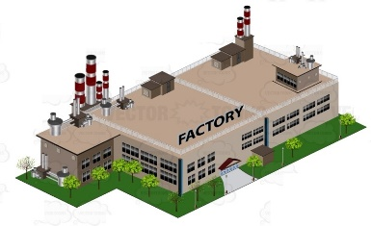
DCMA In-Plant and GEO Support to SMC
In Plant Offices
DCMA Office Resident in Contractor’s Facility
Full Administration Responsibilities for all DoD Government Contracts
Lead Oversight of Major Defense Contracts throughout Supply Chain
Geographic Offices
DCMA Office Centrally Placed within a defined Geographic Area
Functional Specialist Travel to Contractor Facilities throughout the Area
Full Administration Responsibilities for all Contracts within Area
Some in-plant presence

Slide 4
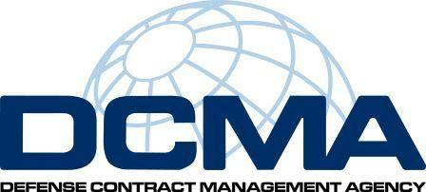
Life Cycle Support
Pre-Award/ Steady State
Production Capacity • Surveys
RFP/Source Selection
Proposal Analyses • Lessons Learned
Contract Performance/
Milestone Decisions
Reality of Production Promises • Negotiation Assist
Indirect/Direct Rate Insight & Negotiations
Contract/Clause Construction • Anticipated Tech Shifts
Assess Risk
Business System Adequacy
Closeout
Subcontract Insight • Fraud Investigations
Root Cause Analyses • Production Status • Delivery Status
Contractor Performance Assessment Report Input
Program Assessment Reports
Payment Authorizations/Withholds
Pricing
• Negotiate Final Rates
• Reconcile Deliverables
• Contract Closeouts
• Property Disposition
• Funds Release

Slide 5
Success Oriented Goals
DCMA is a customer-focused and adaptive Agency that evolves to meet its customer needs
DCMA will work with our customers to create opportunities to capitalize on DCMA’s expertise, presence, and infrastructure

